Slide 1
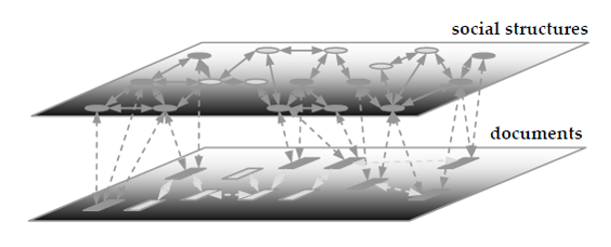
Day 1 - Introduction to Lucene/Solr
Core Tech @Trend Micro
吳奕慶 YI-CHING WU

Slide 2
Agenda
What is a search engine?
Introduction Lucene and Solr?
Advantages of Solr
Solr Architecture
Query Syntax
Setup Solr Configuration files
Working with Solr : Feed data ,query data

Slide 3

Reference
Solr in Action

Slide 4
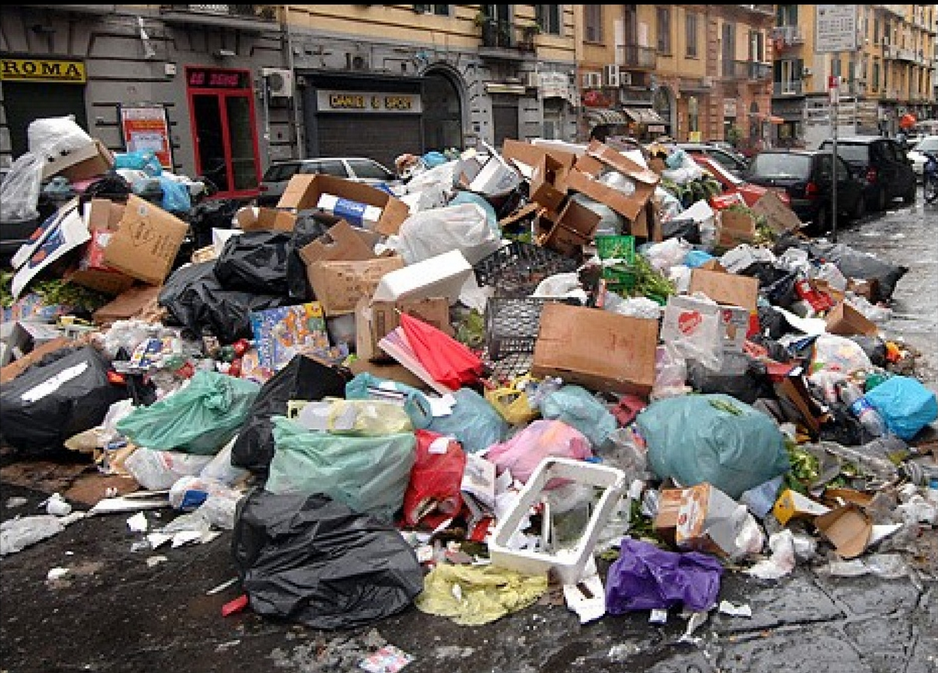
Why do I need a search engine?
Is it easy to search here?

Slide 5
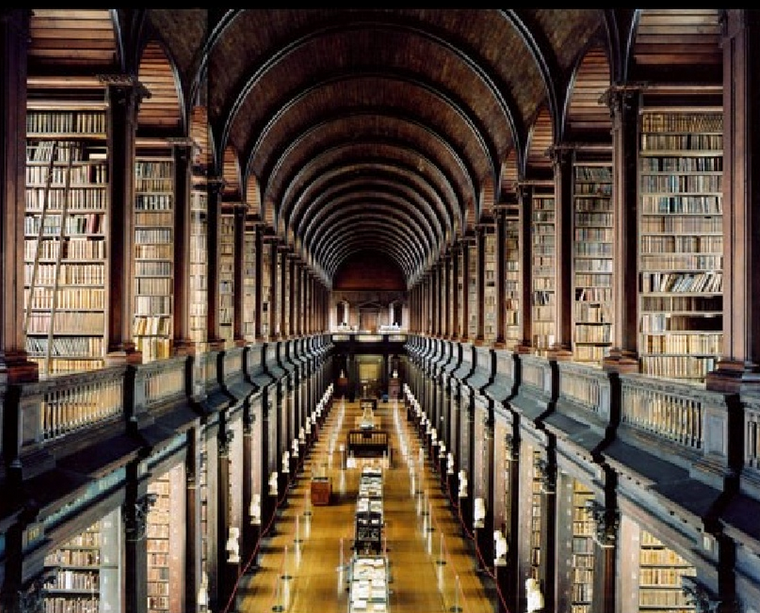
Why do I need a search engine?
Or here?

Slide 6
Let’s start with Indexing
That’s information like a garbage
No structure
Come in all kinds of shapes, sizes, formats

Slide 7
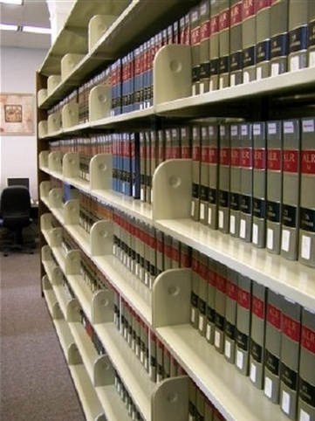
Let’s start with Indexing
This is what index does
Makes data accessible in a structure format, easily accessible through search

Slide 8
Which one can be indexed and searched?
Various file formats
HTML
Text Files
Word
PDF
PPT
…

Slide 9
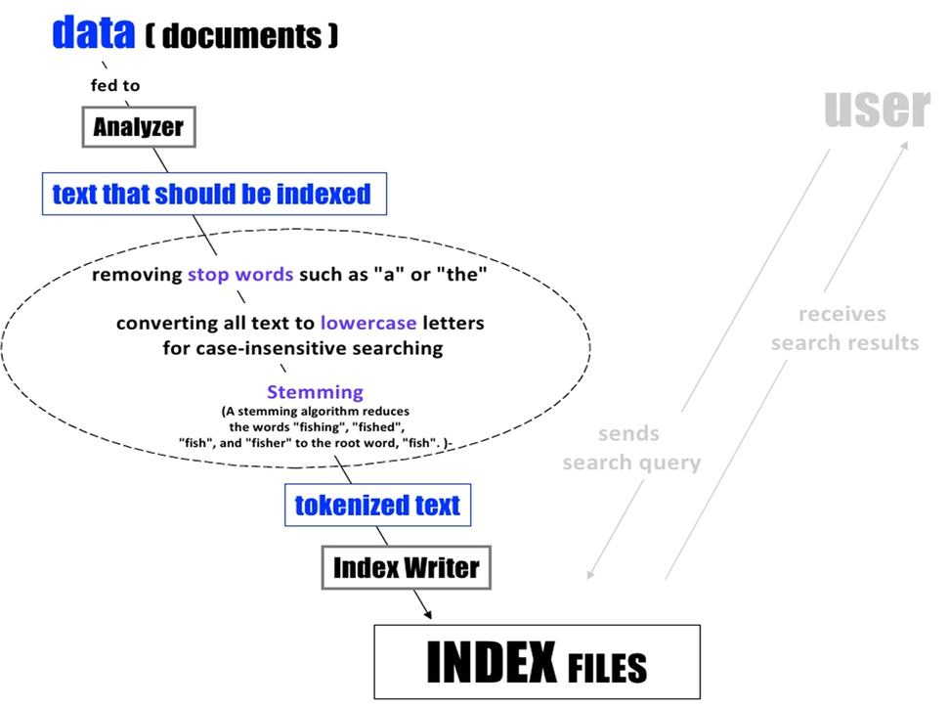

Slide 10
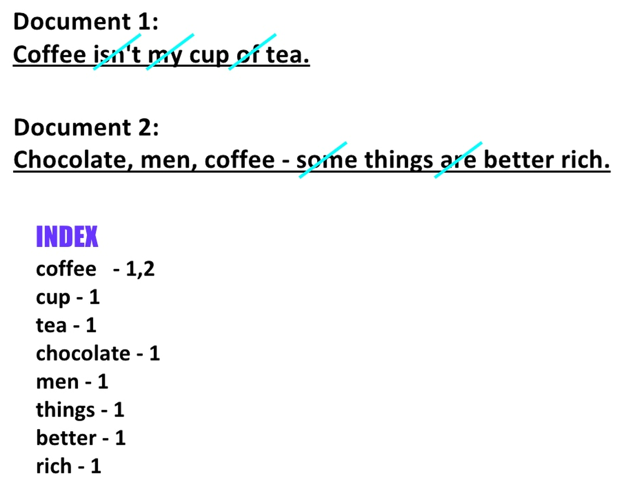

Slide 11
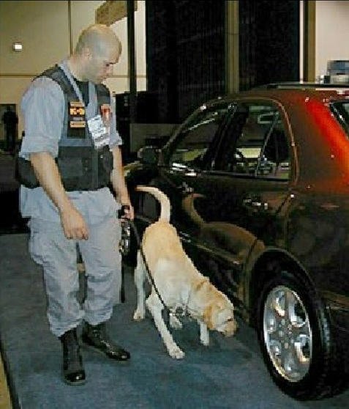
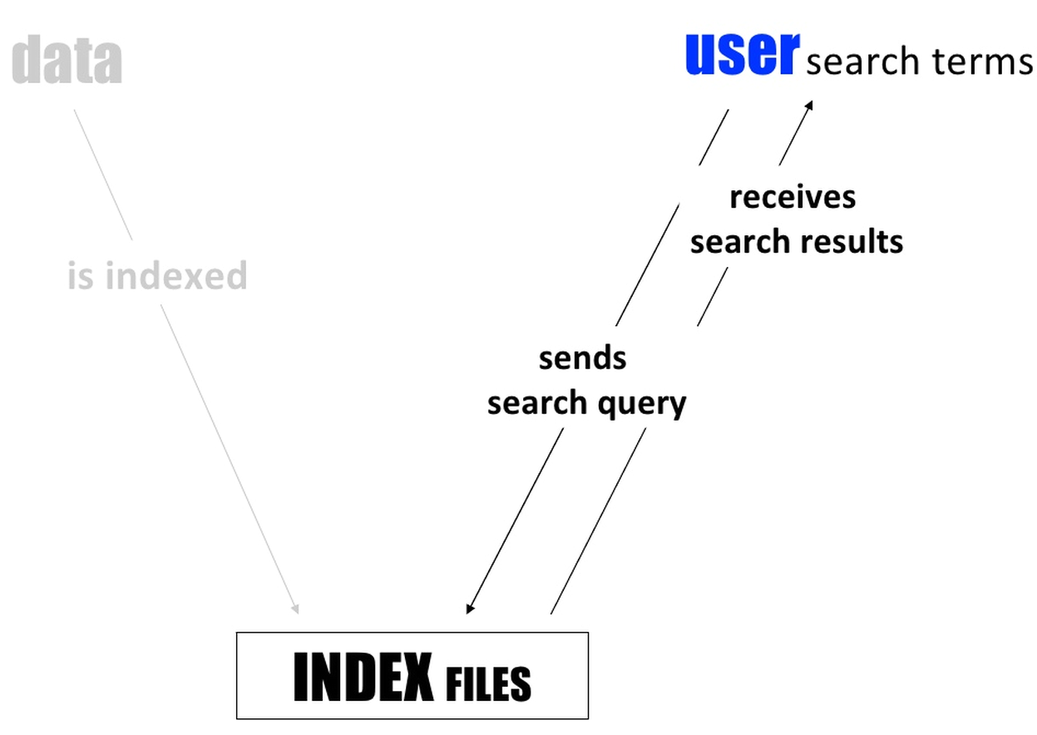
And now the search component

Slide 12
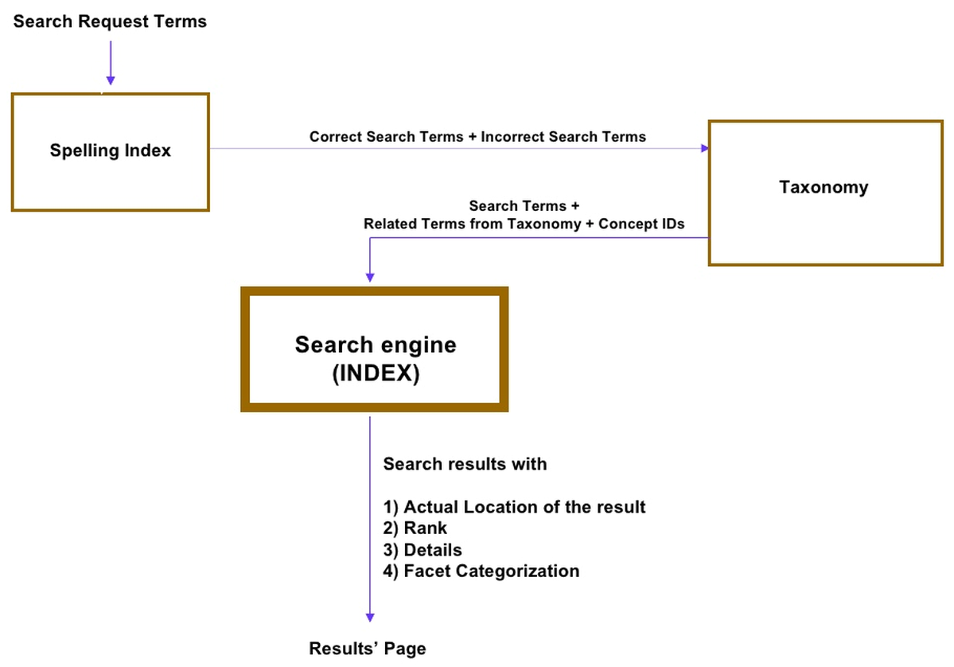

Slide 13
What is a search engine?
Indexing Component
Search Component
Index Files
Data
Users
Sends
search query
Is Indexed
Receives search results
Notes:
Relevance ranking
Integrates different data source (web page, email, files, database, etc.)

Slide 14
Introducing Lucene
Created by Doug Cutting
Not a application but is a Full-text search library (Java language)
Open source project (Since 2000.3~)
Mature
Easy to learn API
Store its index as files on disk
No Web Crawler
http://lucene.sourceforge.net/talks/pisa/

Slide 15
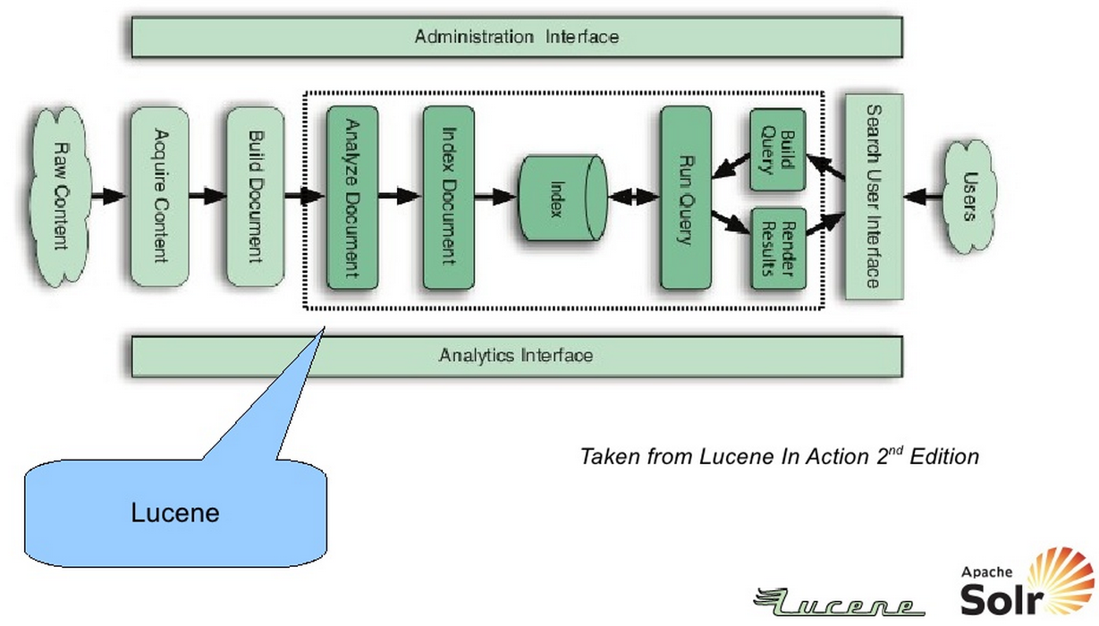
Typical search application

Slide 16
Search?
If you want to find a word in a book : how do you do it?
Naïve approach : linear-search
O(n) : slow
Inverter index

Slide 17
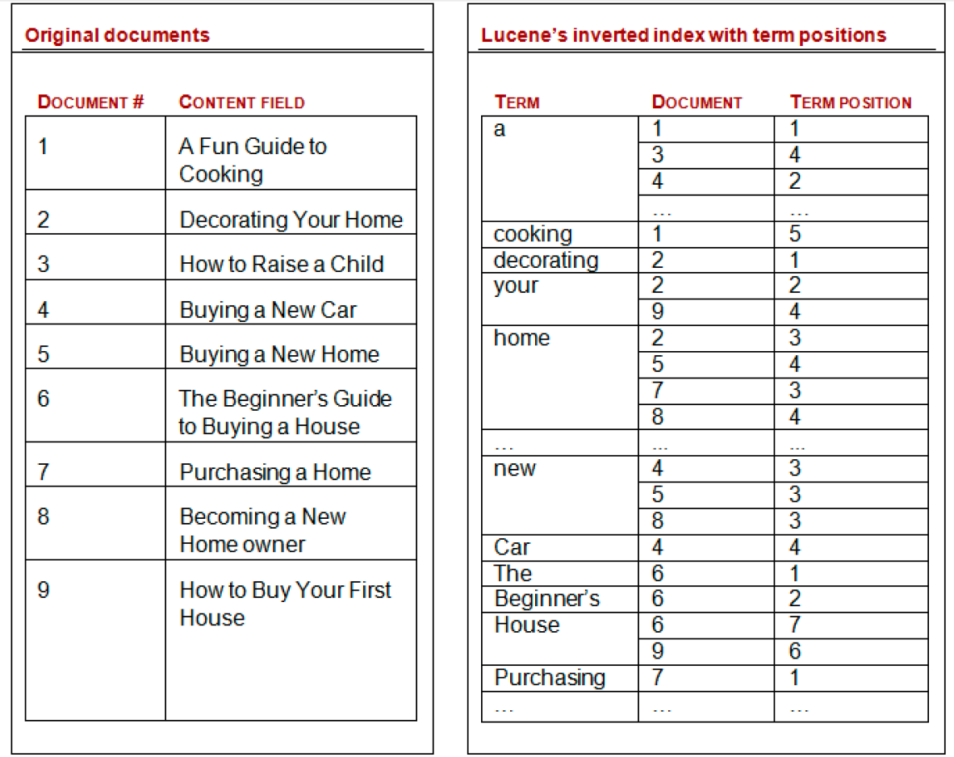
Inverter index

Slide 18
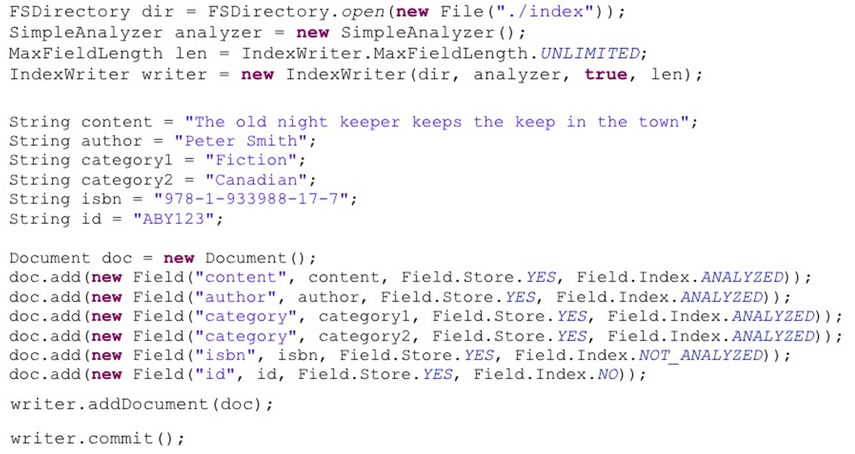
Indexing with Lucene

Slide 19
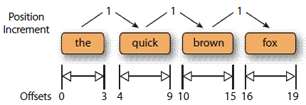
Fields of Lucene
Indexed
Put the content in the inverter index
Analyzed
Split the content into terms to be added to the inverter index. Normalized terms
Stored
Keep the original content on disk
Multivalued
Repeat the same field multiple times in the same document with different values
OmitNorm
Index time field boost setting
TermVector
WITH_POSITIONS_OFFSETS

Slide 20
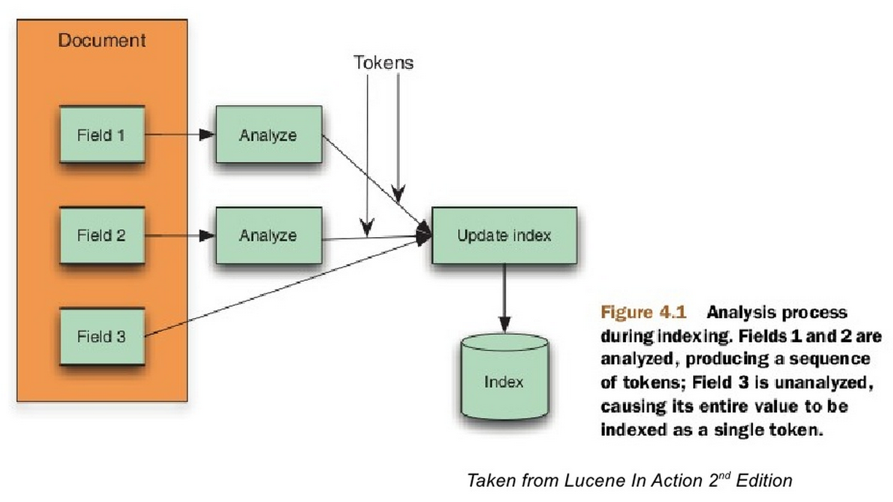
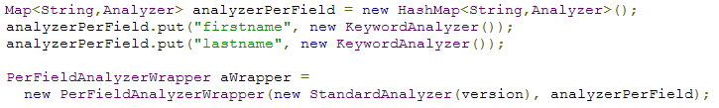
Analyzer
PerFieldAnalyzerWrapper

Slide 21
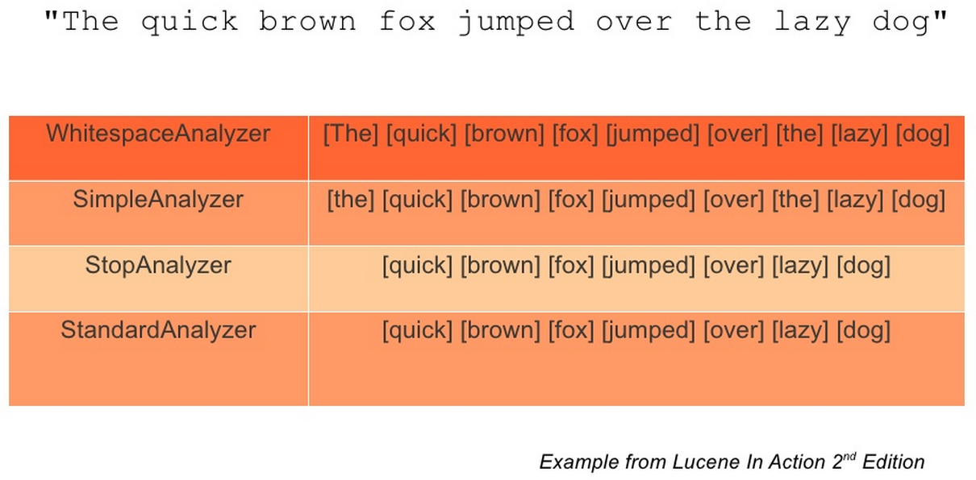
Analyzer

Slide 22
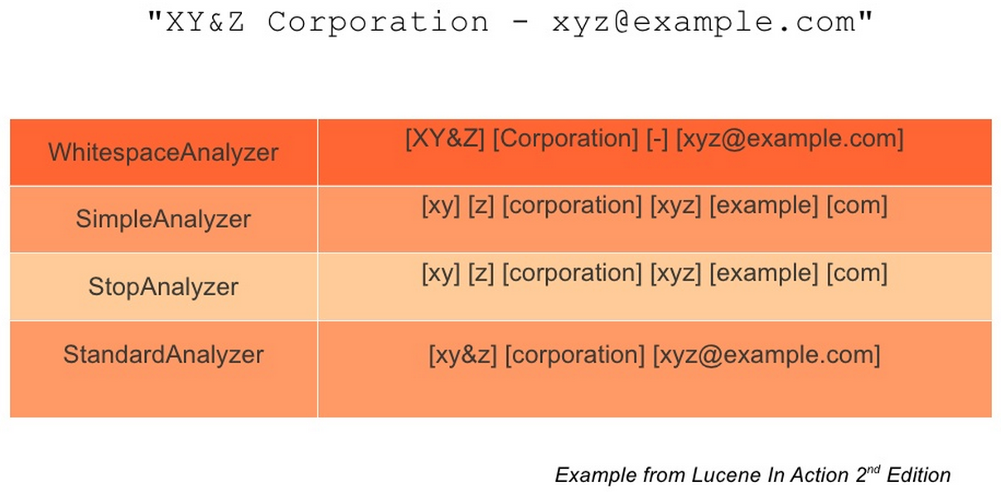
Analyzer

Slide 23
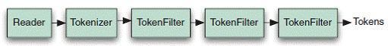
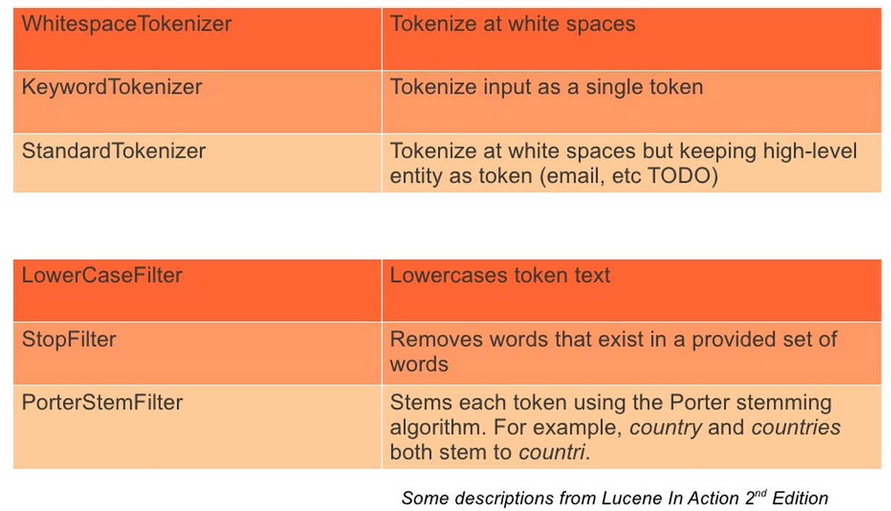
Custom Analyzers

Slide 24
Query with Lucene
Ask Lucene “What documents contain this words?”
Lucene applied an Analyzer to each word queried.
Query can be programmatically build powerful Query Syntax.

Slide 25
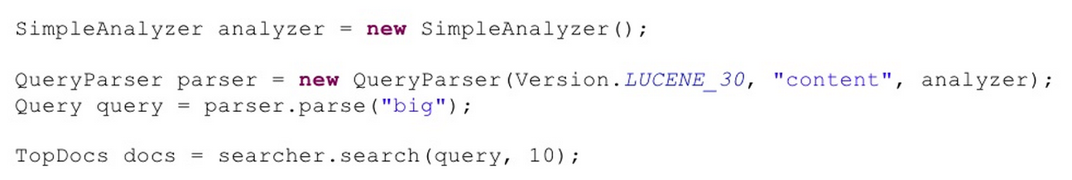
Query Code
Query Syntax :
http://www.lucenetutorial.com/lucene-query-syntax.html
http://lucene.apache.org/core/3_5_0/queryparsersyntax.html

Slide 26
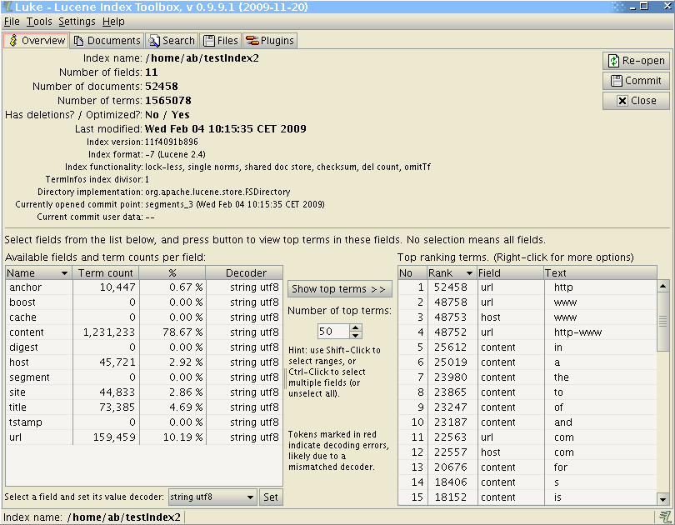
Luke for Lucene Index

Slide 27
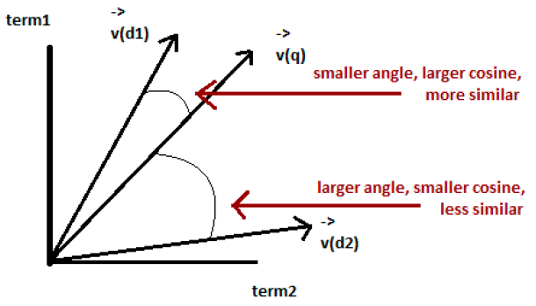
Relevancy scoring
N dimension vectors for documents and queries
Score represents how close the vectors are
TF-IDF(term-frequency-inverse document frequency)
Document with many of the search terms are scored higher
Smaller documents are scored higher

Slide 28
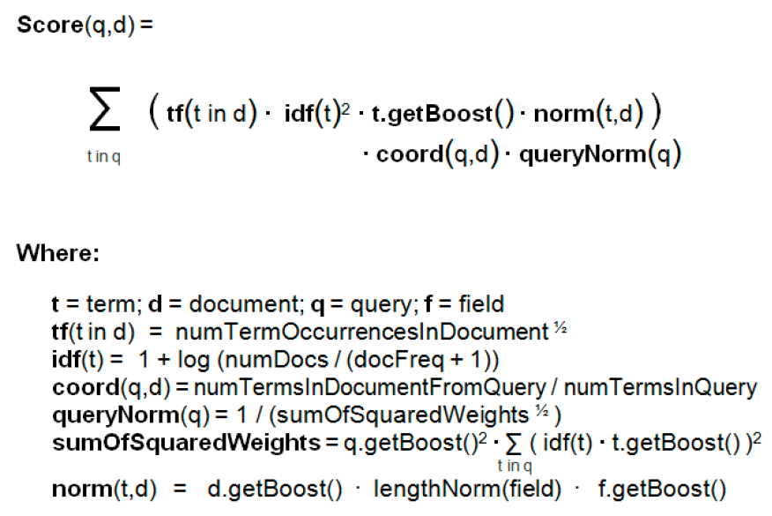
Default Similarity Scoring Algorithm

Slide 29
Introducing Solr
Created by Yonik (since 2004)
Open source(released in 2006)
Http Application built around Lucene
Make it easy to develop search solutions
Most programming tasks in Lucene are configuration tasks in Solr
Advanced features develop on top of Lucene
Data importer, faceting, filter, similarity , replication and distributed search support, dynamic field, etc.
As of 2010, Lucene and Solr are merged development codebases

Slide 30
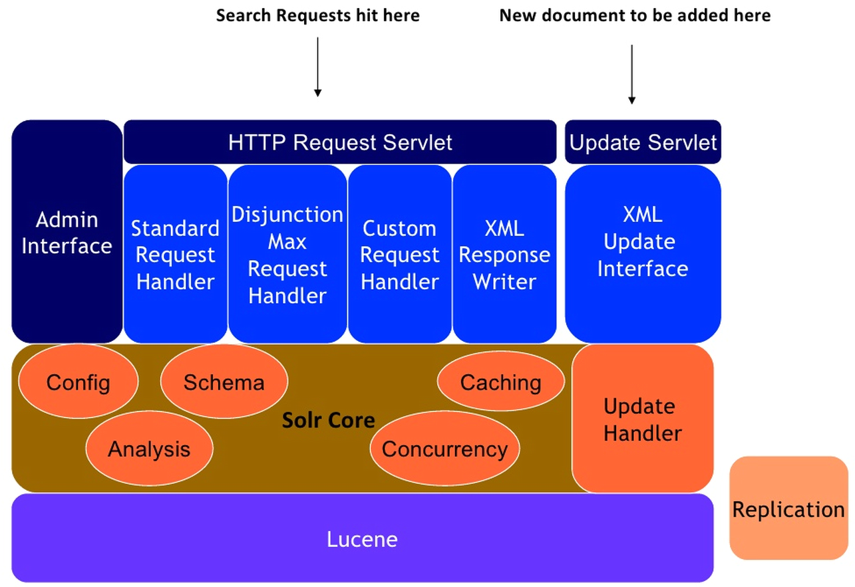
Solr Architecture

Slide 31
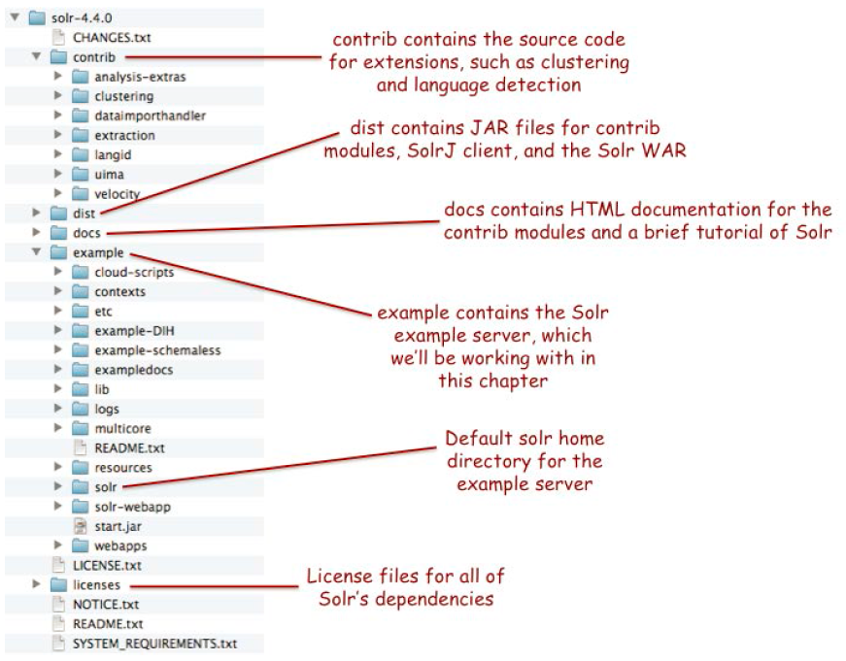
Solr Archived Folders and Files

Slide 32
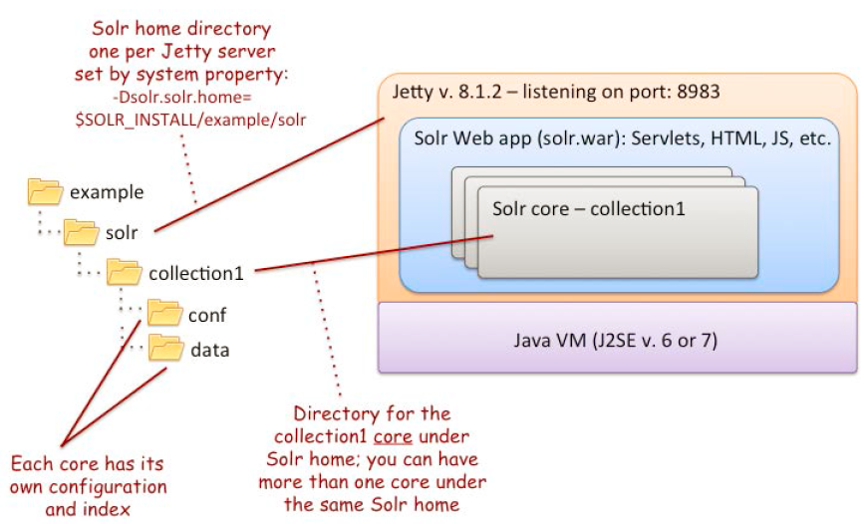
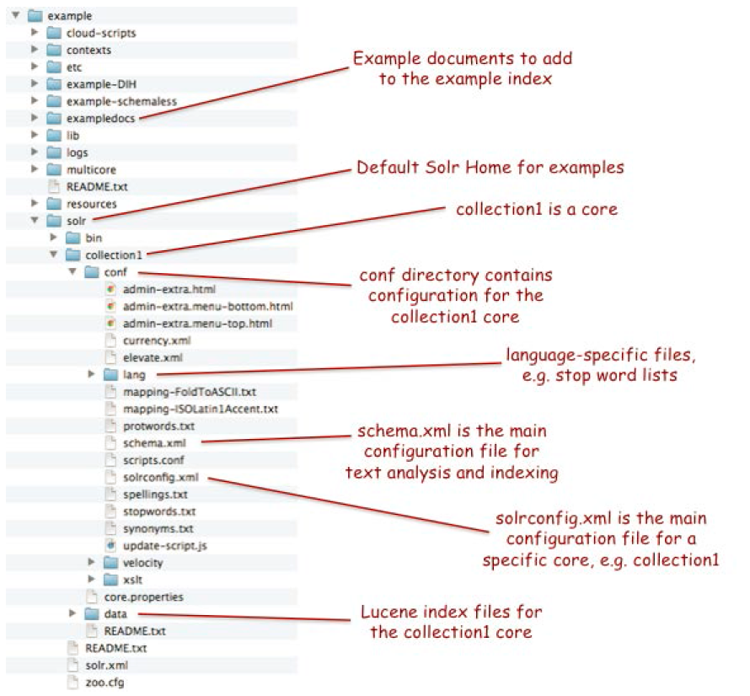
Understanding Solr Home

Slide 33
Solr Features
Dismax
Edismax
Text Highlight
Spell Checking
More Like This
Cache
Replication
Database connector
Spatial (Geo-location)

Slide 34
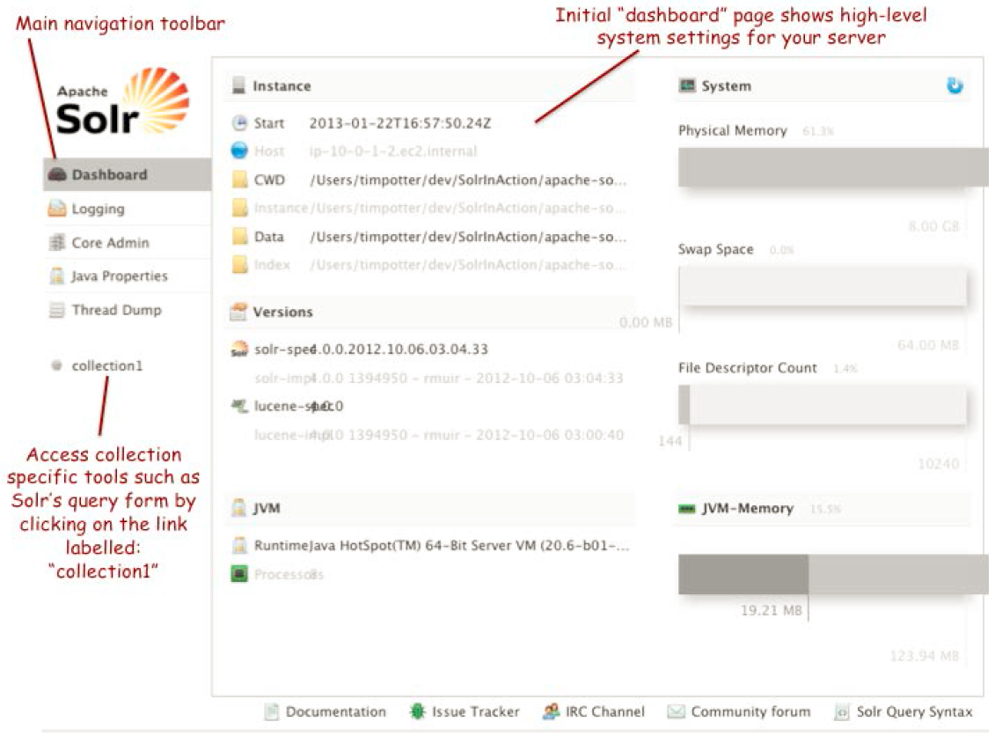
Solr Administration Console

Slide 35
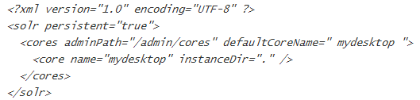
Solr.xml

Slide 36
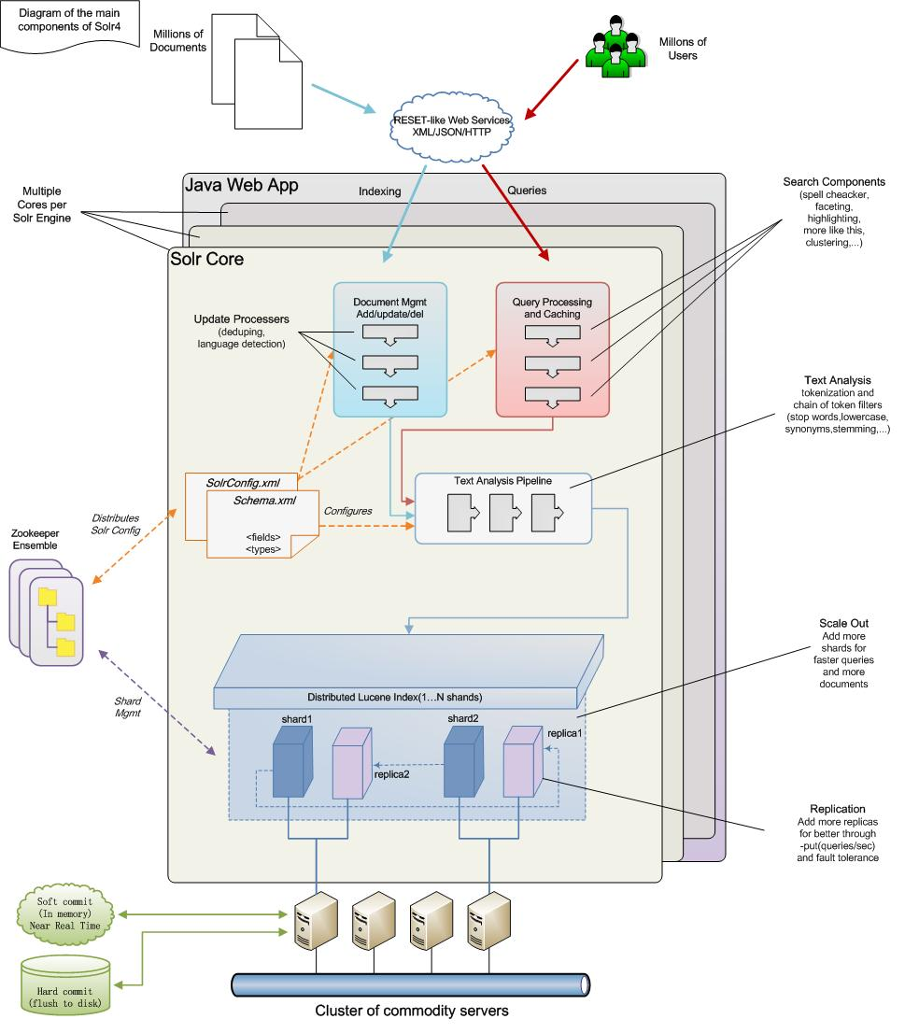
Diagram of the main components of Solr 4.x

Slide 37
Solr Schema
Solr allows to administer one or more Lucene Index
Each index has its own schema
List all fields allowed for an index
Defines the analyzers for each field
http://wiki.apache.org/solr/AnalyzersTokenizersTokenFilters

Slide 38
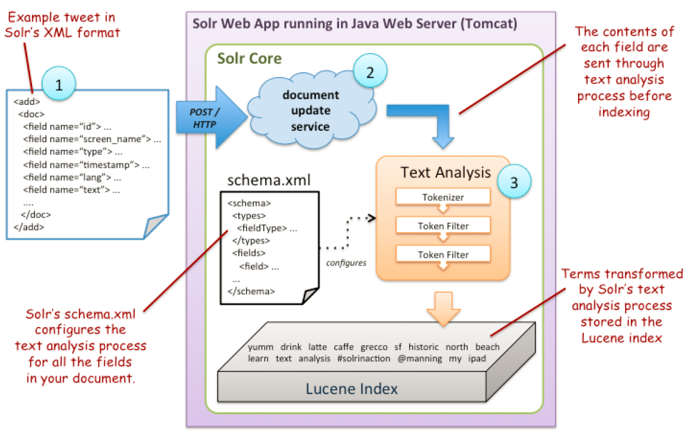
Three Main steps to index a document

Slide 39
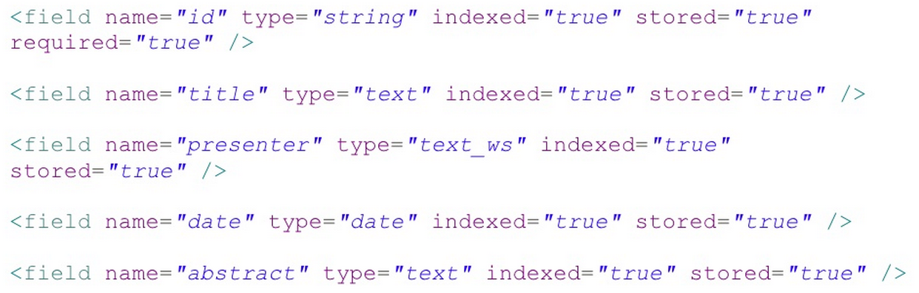
Solr Schema -Conf\schema.xml

Slide 40
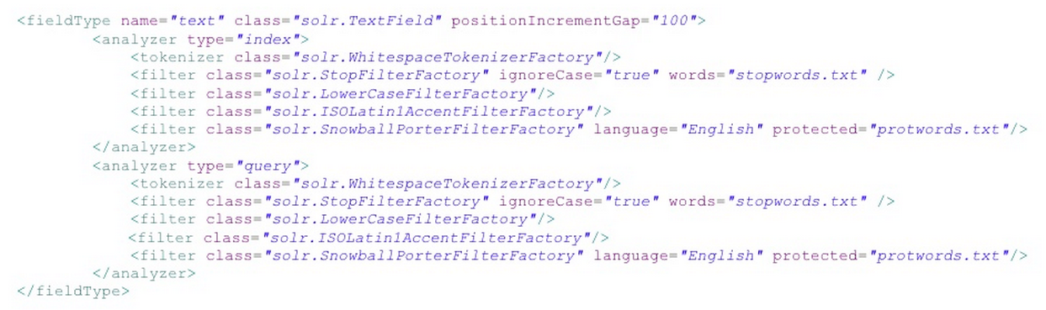
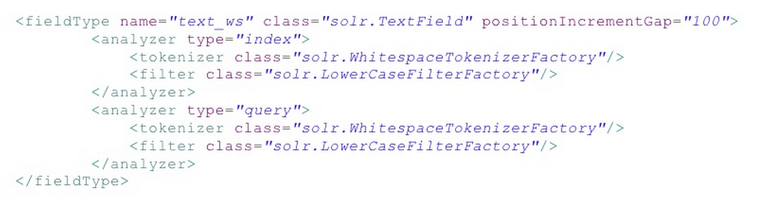
Solr Schema -Conf\schema.xml

Slide 41
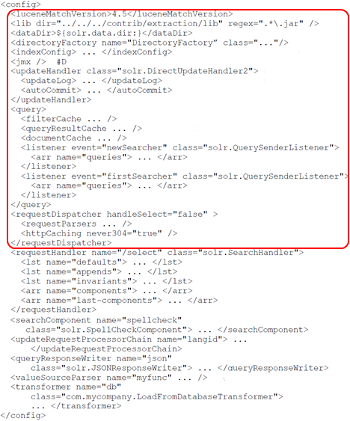
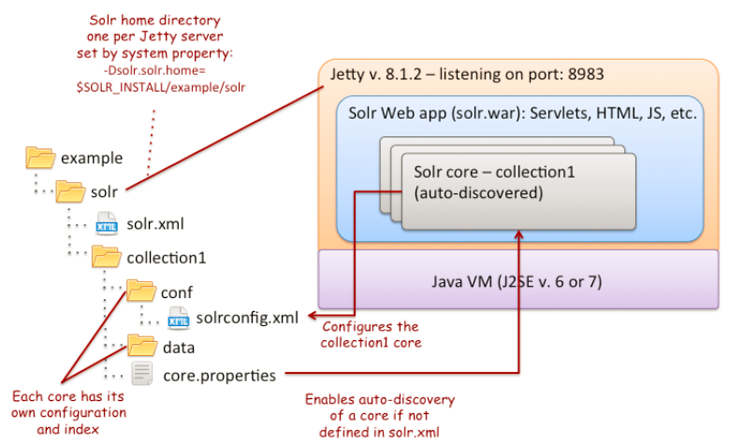
Solr- solrconfig.xml
Notes:
#A Activates version-dependent features in Lucene
#B Lib directives indicate where Solr can find JAR files for extensions
#C Index management settings
#D Enables JMX instrumentation of Solr MBeans
#E Update handler for indexing documents
#F Cache-management settings
#G Register event handlers for searcher events, for example, queries to execute to warm new searchers
#H Unified request dispatcher
#I Request handler to process queries using a chain of search components
#J Example search component for doing spell correction on queries
#K Extends indexing behavior using update-request processors, such as language detection
#L Formats the response as JSON
#M Declares a custom function for boosting, ranking, or sorting documents
#N Transforms result documents

Slide 42
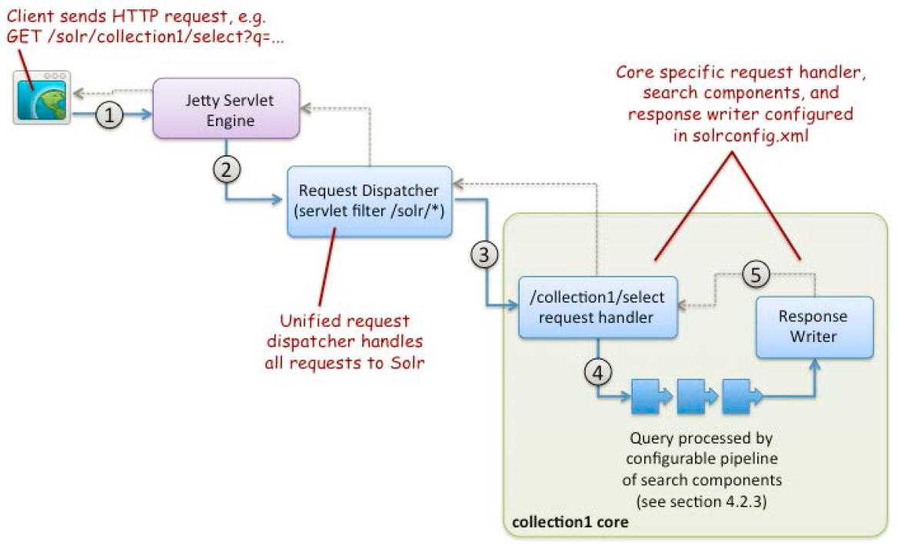
Solr Request Handler

Slide 43
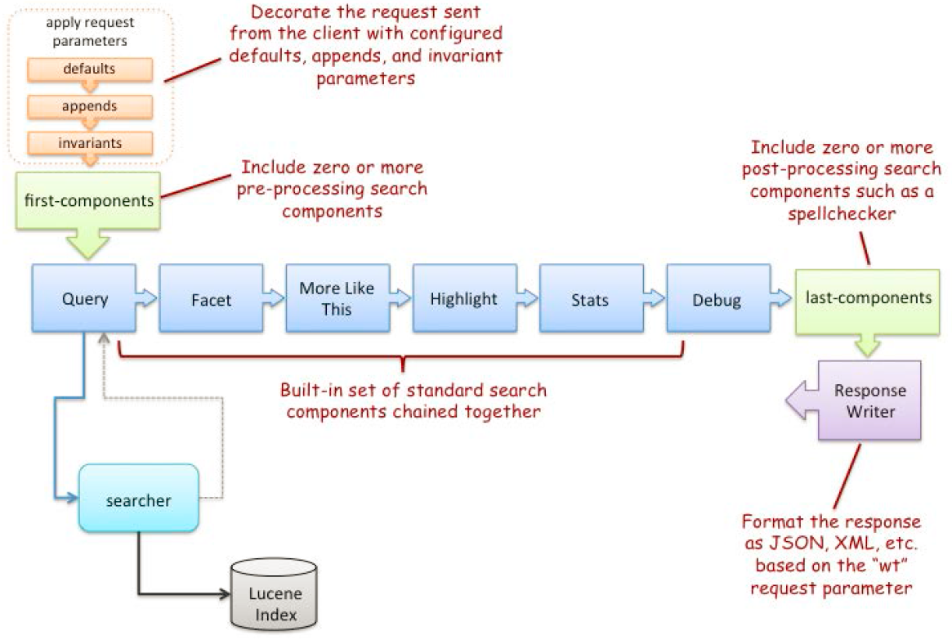
How request handlers process Queries?

Slide 44
Solr Indexation
HTTP POST
XML by default, but also json , csv
Multi Threaded

Slide 45
Solr Query
HTTP GET or HTTP POST
Query Parameters
Response in XML by default, but other formats are supported(json, php, ruby, etc.)

Slide 46
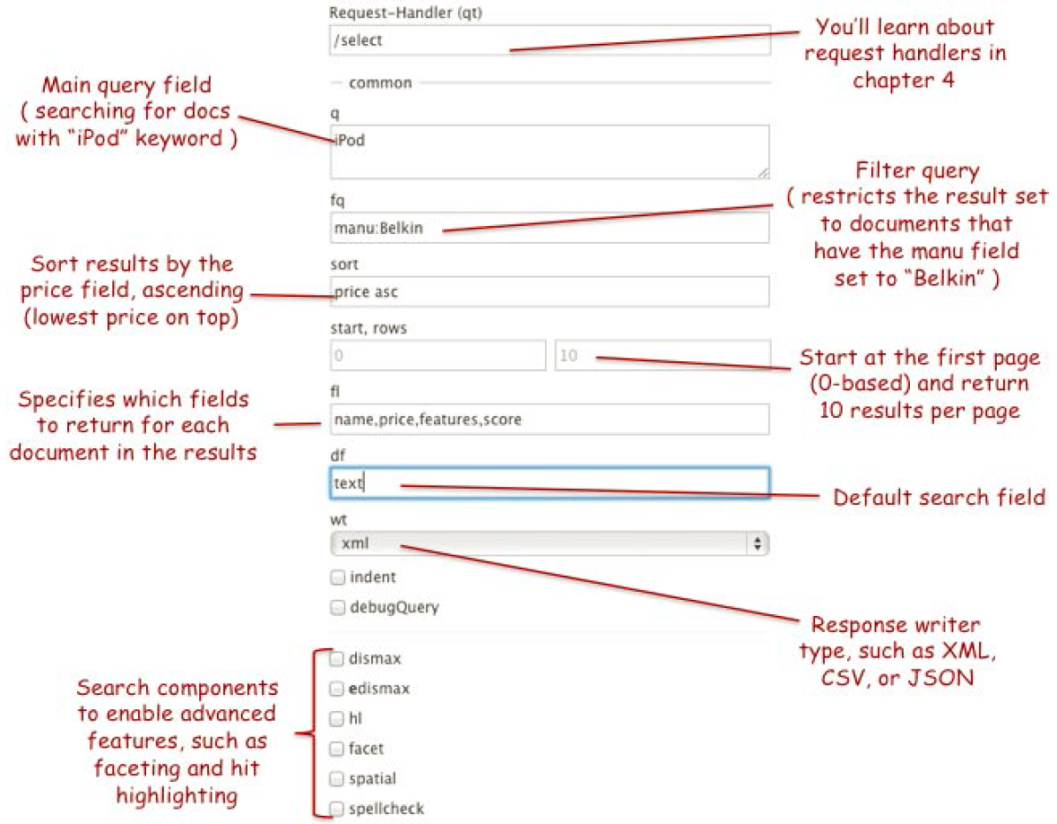
Solr Query using Administration Console

Slide 47
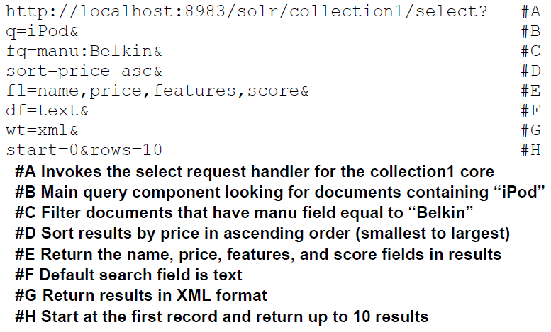
Solr Query Parameters

Slide 48
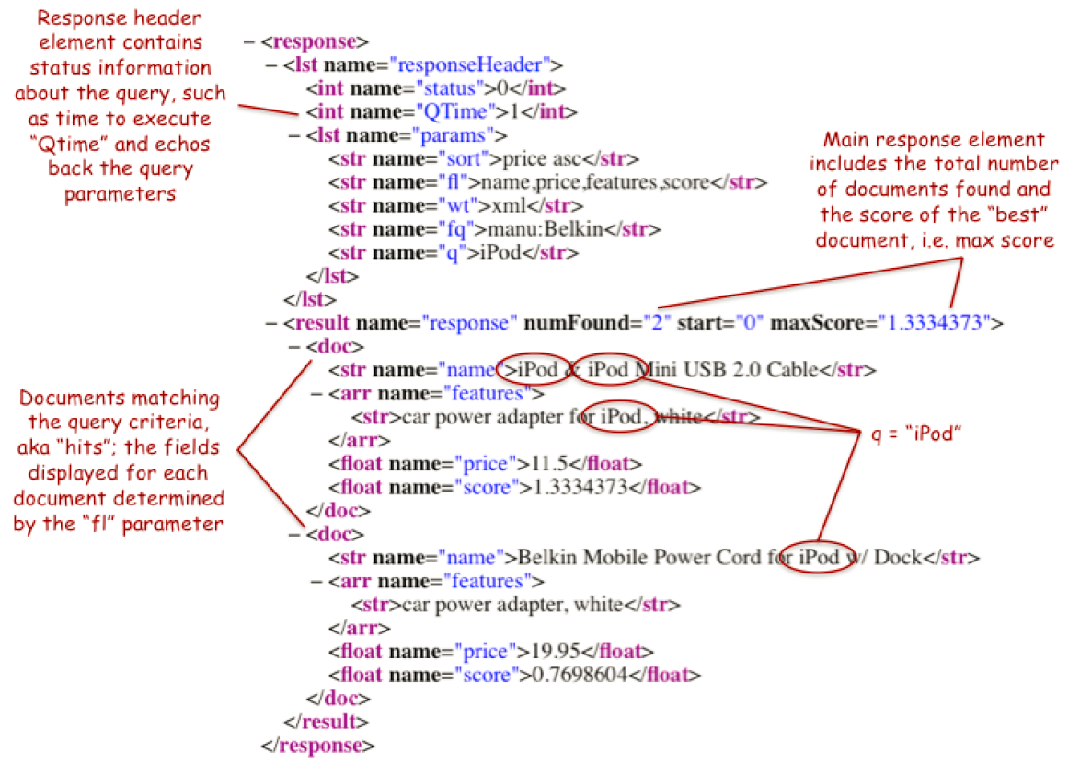
Solr Response in XML

Slide 49
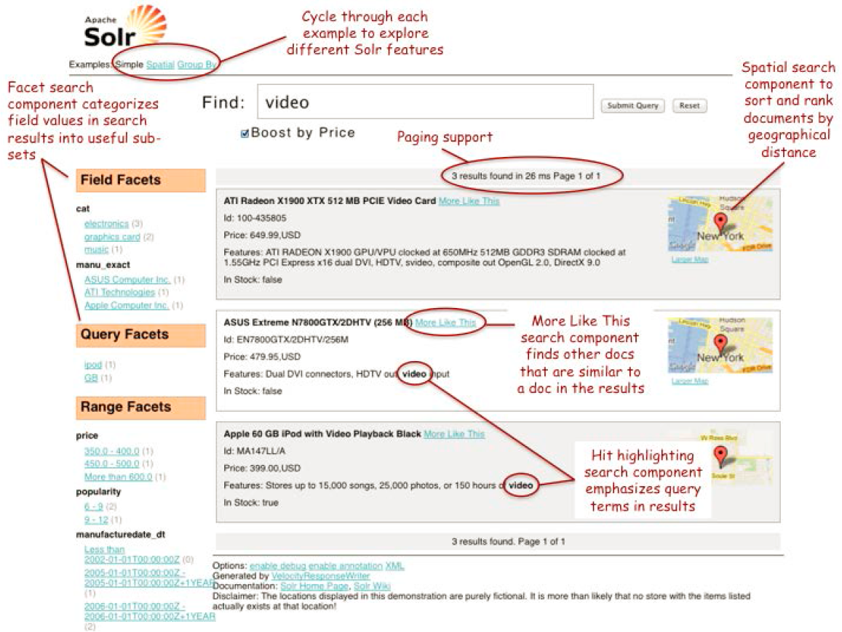
Solr simple example

Slide 50
Q&A

Slide 51
Solr Demo
Using TrendMicro Support knowledge base
Indexed using Solr DataImporter

Slide 52
Thank You!

